Slide 1
Caring Course
Opportunities and challenges of older age
A local church
Autumn 2024

Slide 2
Ageing
Like many small UK churches, ours (usual Sunday morning congregation about 40 people) has more older than younger members.
As we all age there are increasing problems of serious illness, bereavement, loneliness, difficulty walking, lack of balance and failing sight and hearing.
‘Don’t get old’ my patients used to tell me. They were not wrong in thinking that but most of us today are fortunate enough to have the extra years which bring us to old age.

Slide 3
Quote from a 74-year-old
I am old, but I am forever young at heart
We are always the same inside.
Know that you are the perfect age
Each year is special and precious
You can only live once
Do not regret growing older
It is a privilege denied to many

Slide 4
Decision to provide information on ageing
So last autumn (Sept-October 2024) we ran something which we called:
“Caring for one another as years go by”

Slide 5
Caring for one another as years go by
We met twice a month for 2 hours in an afternoon so that everyone could come and return home in the light. About 40 people came, most quite regularly and by no means all church people. We had advertised on local notice boards and local magazines.

Slide 6
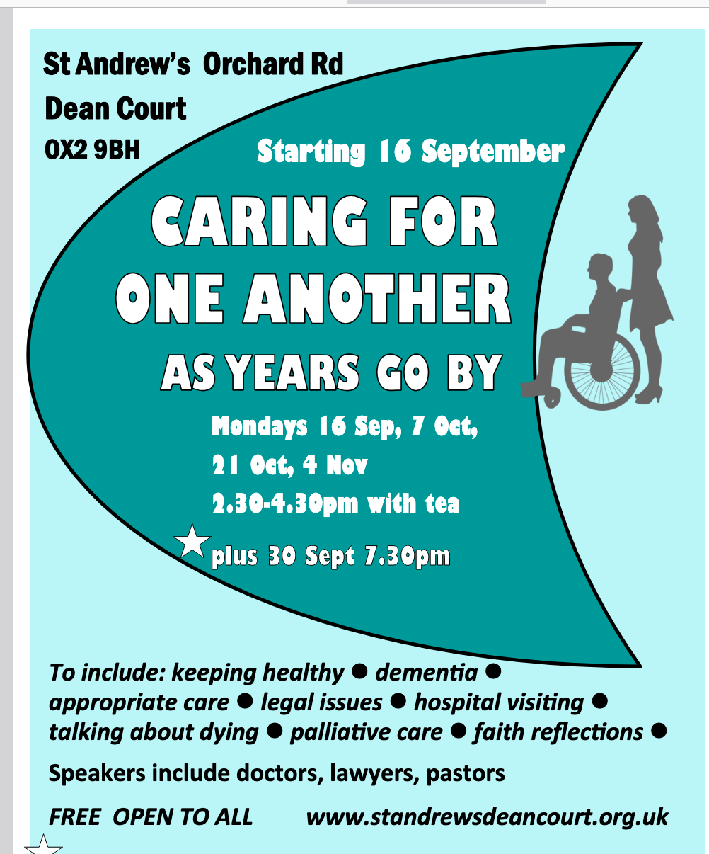

Slide 7
Caring for one another as years go by
I introduced and chaired the meetings.
We had presentations, questions and discussion and a short Bible reflection.
We had a 15-minute break for tea and a piece of cake or biscuit halfway through.
At the first meeting a wonderful 91-year-old presented on:
Getting Older:-
The Challenges and Opportunities in Senior Life.

Slide 8
Opportunities and challenges of Older Age Our first session
A retired doctor aged 91.
Exercise your body, your mind and your spiritual life

Slide 9
Positives and negatives
“There is nothing whatever the matter with me,
I’m just as healthy as I can be -
But I have arthritis in both of my knees,
And when I walk - I talk with a wheeze.
My pulse is weak and my blood is thin,
But I’m awfully well for the state I’m in.”

Slide 10
The message
There will be challenges but there are also opportunities
in older age.

Slide 11
Five recommendations
Physical Exercise
Stimulate your brain
Develop your social life
Engage a Spiritual dimension
Identify a Purpose

Slide 12
1. Physical Exercise For Health of the Body
House and garden work
Brisk walking
Going up and down the stairs
Running
Cycling
at least 30 mins a day 3-4 times a week exercise muscles, including heart, reducing risk of some diseases.

Slide 13
2. Stimulate your brain
Try to learn something new every day:
puzzles
word and number games
join groups of those with similar interests.

Slide 14
3. Develop your social life
keep in touch with family and friends
make new friends
speak to those you don’t know and make new contacts

Slide 15
4. Engage a Spiritual dimension for your life
Weekly worship
Bible reading and prayer daily
Group Bible Study

Slide 16
Identify a Purpose for your life
Set Priorities.
What do you really want to do?
A good deed every day?
Encouraging others?
Writing some poetry?
Offering hospitality?

Slide 17
Healthy eating in Later Life
A nutritionist gave a simple explanation of types of foodstuff:
Protein – Body building foods (meat, fish, eggs) – need some but not large amounts
Carbohydrates – Our staple, filling foods (rice, cereals, potatoes) - each culture has its own depending on preference and availability
Fats – Butter, cream, lard, fat from meat. Go easy on these
Fruit and vegetables: these are good for us, they don’t add much weight
A ‘good’ diet is mixed and varied.

Slide 18
Supporting Older People 2nd Session
Two retired (female) church pastors spoke from their experiences of visiting and the needs they had found.

Slide 19
Visiting in the community:
the sick both acute and chronic illness,
the bereaved
most of all the lonely
those in care homes

Slide 20
Visiting in hospital
not always wanted
sometimes patients are too busy
take a card to leave with them
think of things to tell them about/ take a simple game to play/ articles of interest to read.
Go prepared if possible.

Slide 21
Visiting - general
Confidentiality and privacy important
Not all will want to tell you what is wrong with them.
Check who you can share any information with.
Active listening is important
Talking can be tiring
Concentration can be poor when you are ill.

Slide 22
Dementia 3rd Session
The talks were from 2 men whose wives developed dementia.
One was in her 70’s and one in her 80’s when it developed The disease increases in incidence with age.

Slide 23
Ageing and dementia
There are many things which happen to our minds as we age
We can’t remember names or where we put things, we worry that we are developing dementia (most won’t but some of us will).
1 in 7 over 80yrs old have dementia
1 in 3 over 90yrs old have dementia

Slide 24
Dementia: How common?
In UK in 2024:
1 million people have Dementia
(of total of 70 million UK population)

Slide 25
Dementia: what can be done?
There is no Medicine Cure for Dementia
But much can be done to help those on the Dementia Journey.

Slide 26
Dementia, how to help
Engage medical services – a diagnosis is helpful, there might be medication to slow the progress.
Family and friends can give invaluable support and practical help.
Voluntary agencies might have dementia clubs to help sufferer and carers.
Day to day advice: don’t argue or try to correct the sufferer, you might add to their confusion.
Use distraction (shall we have a cup of tea/ go into the garden).
Patience and unending love are needed in this difficult journey.

Slide 27
Caring Course 4th session
Funerals
legal aspects
talking about dying

Slide 28
Funerals
our vicar spoke on funerals

Slide 29
Legal Aspects
a lawyer spoke on:
1.Wills: It is very important that we all have an up to date Will: what we want to happen to our money and possessions after our death
2. Power of Attorney - where a person can nominate another person/persons to act on their behalf if they become unable to make decisions for themselves.

Slide 30
Talking about dying
This was my opportunity to talk about the book I have written on the subject.
There is a web site where you can find the book and other content.
www.talkingaboutdying.org
I also did a short presentation on Assisted Suicide and Palliative Care. (Some think, wrongly, that palliative care is assisted dying).

