Slide 1


Scope of Palliative Care
Dr. Jenifer Jeba S
MD (RT), Dip Pall Med, MSc Pall Med (Cardiff)
Professor and Head,
Department of Palliative Medicine, Christian Medical College, Vellore.
Honorary Senior Lecturer, School of Medicine,
Cardiff University
24 Jan 2023

Slide 2
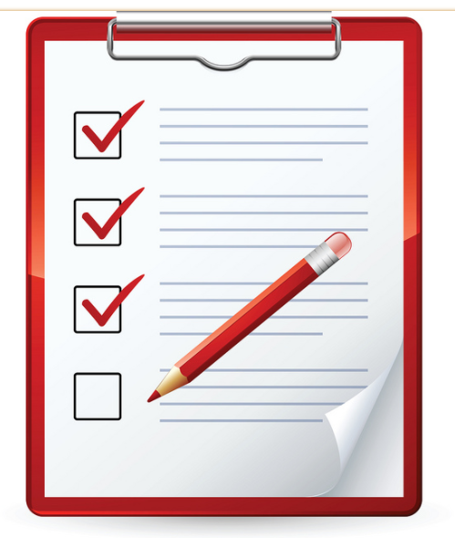
Outline
Palliative care
Why?
Big need and response
By whom?
When?
For whom?
How to do this in practice?
Challenges

Slide 3
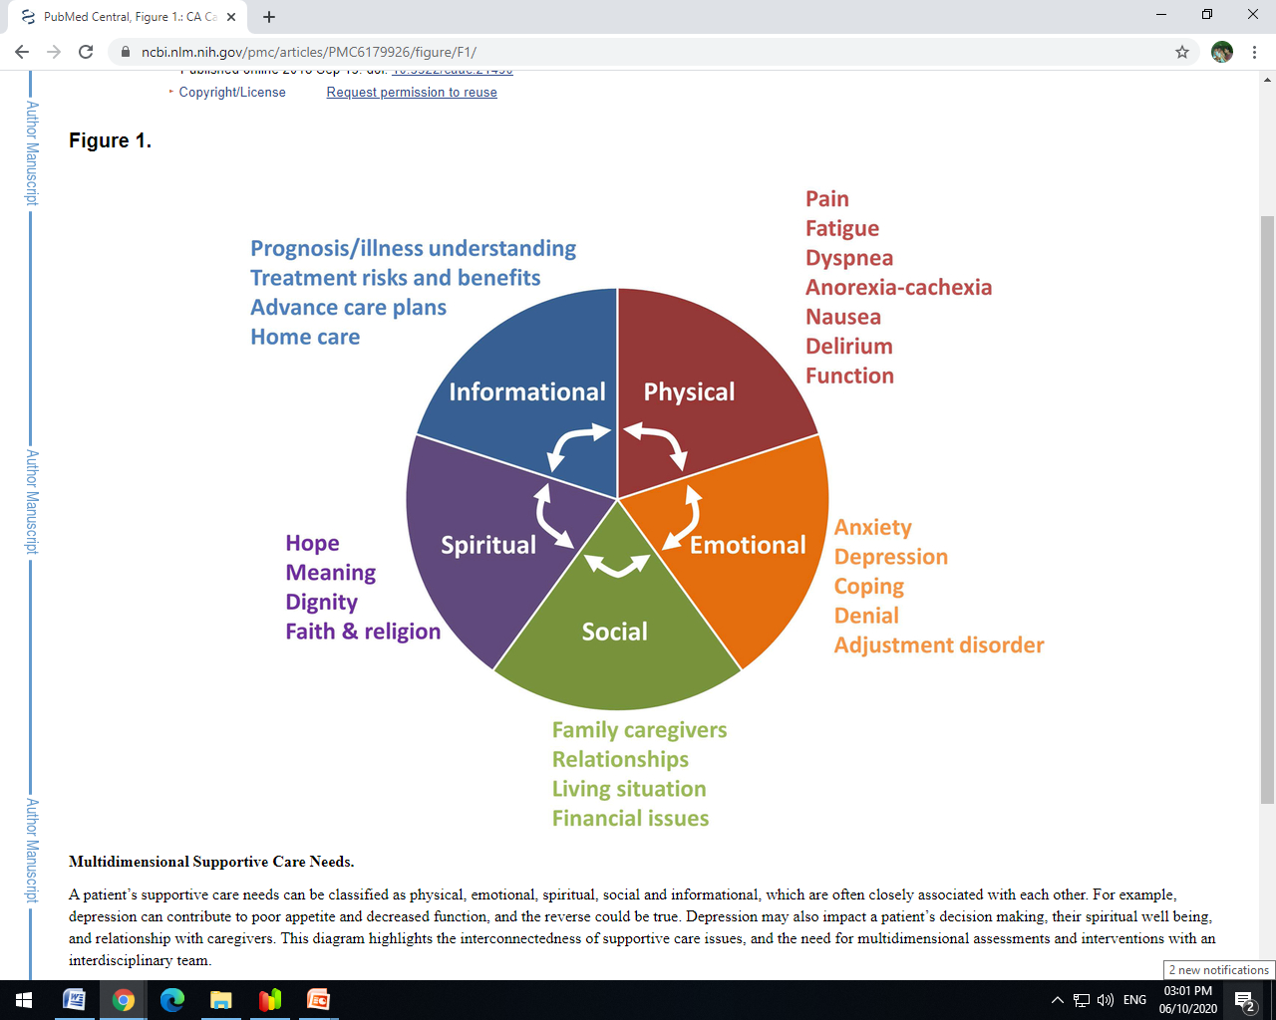

Complex multi-dimensional needs
Young lady with metastatic ovarian cancer
Multiple lines of cancer directed treatment
Keen for more (family or patient)
DISTRESS
Patient – total pain
Husband and extended family
Palliative care team
Adequate symptom relief
Decision making – family meeting - stop oncological treatment
Short hospital stay to optimise symptom control
Desire to continue care at home
Family members empowered
https://www.ncbi.nlm.nih.gov/pmc/articles/PMC6179926/figure/F1/
https://www.istockphoto.com/photo/iceberg-floating-gm620734050-108320227

Slide 4
Palliative Care is NOT synonymous to End of Life care
“Palliative care is the active, total care of patients with progressive, far advanced disease and limited life expectancy whose disease is not responsive to curative treatment …..” (WHO 1990)
Palliative care is an approach that improves the quality of life of patients and their families facing …..with life-threatening illness, through the prevention and relief of suffering by means of early identification……“ (WHO 2002)
Consensus-based Definition (2020)
Palliative care is the active holistic care of individuals across all ages with serious health-related suffering due to severe illness and especially of those near the end of life…..
Radbruch L, et al. Redefining Palliative Care-A New Consensus-Based Definition. J Pain Symptom Manage. 2020;60:754-764

Slide 5
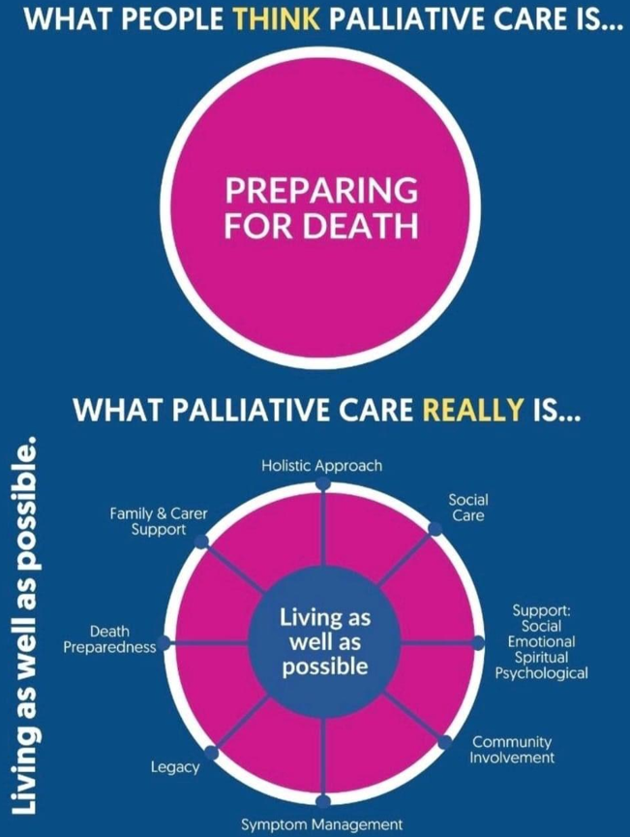
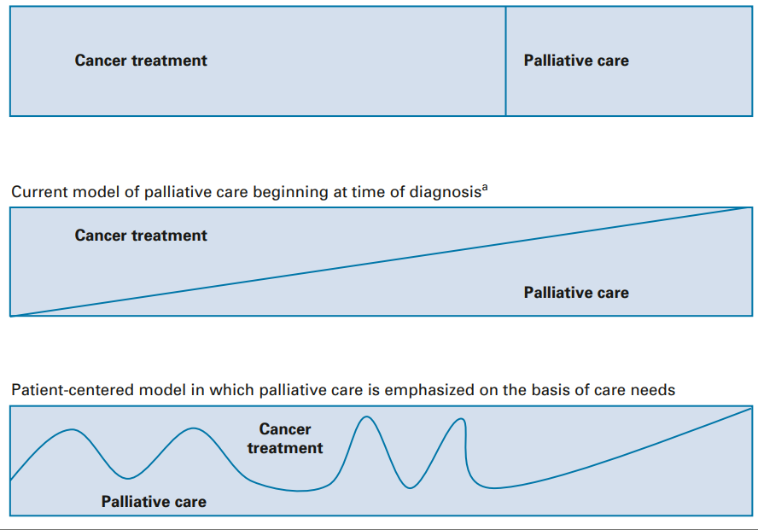
Palliative care – when?
Disease modifying treatment
Disease modifying treatment
Disease modifying treatment
Temel JS, Petrillo LA, Greer JA: Patient-centered palliative care for patients with advanced lung cancer. J Clin Oncol 40:626-634, 2022

Slide 6
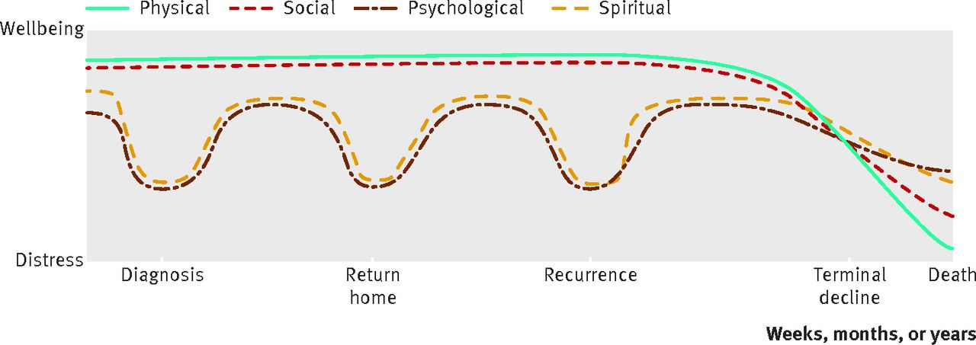
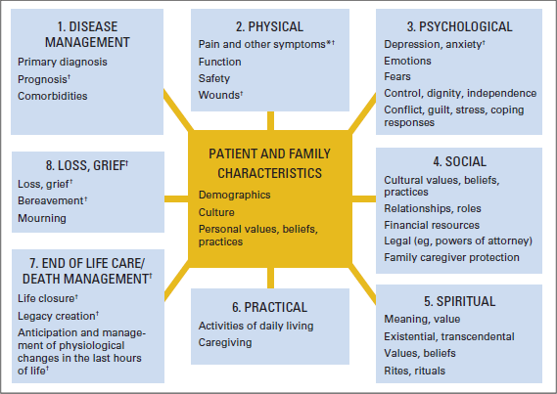
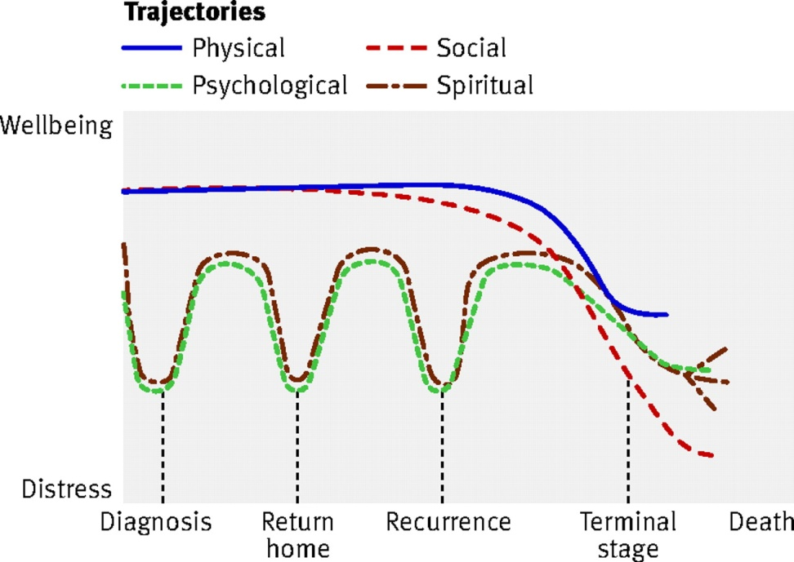
Need to REDUCE SUFFERING – TOTAL CARE
PATIENT
Ongoing support/ changing needs – EVERYONE SHOULD BENEFIT EARLY
CAREGIVER
Ferris et al., JCO 2009; 27:3052-8
Scott A Murray et al. BMJ 2010;340:bmj.c2581
Notes:
Social trajectory closely follows the physical trajectory, but the psychological and spiritual trajectory is worse at four diff times, so patients will benefit from PC even when they are otherwise physically well

Slide 7
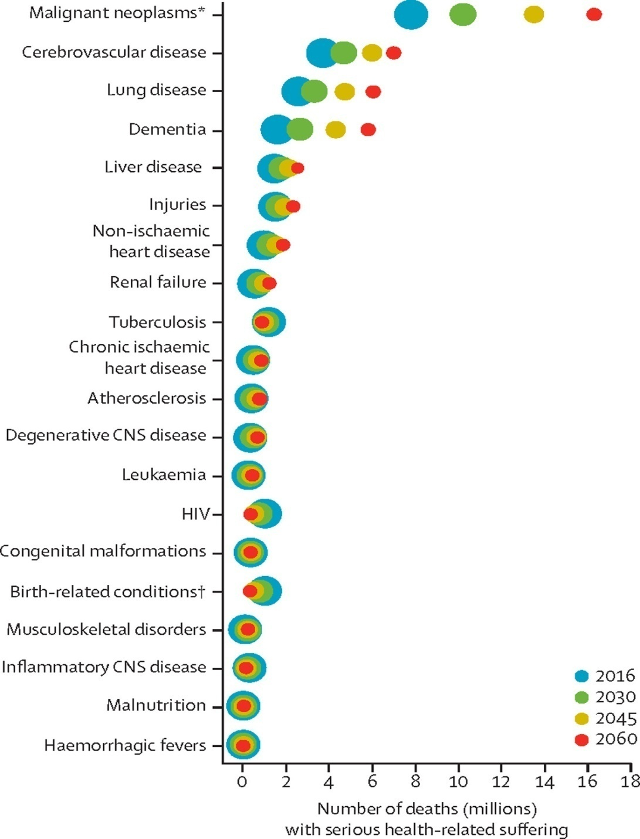
Health conditions driving the global burden of SHS
Changing population demographics
Changing disease epidemiology
More deaths from chronic non-communicable diseases
UHC is not possible without a universal approach to palliative care through primary care teams
Need to empower health care teams
Sleeman KE, et al. The escalating global burden of serious health-related suffering: projections to 2060 by world regions, age groups, and health conditions. Lancet Glob Health 2019; 7: e883–92.

Slide 8
Need for palliative care (WHO key facts)
40 million people are in need of palliative care each year
78% live in low- and middle-income countries
Only 14% of those who need receive it
https://www.who.int/news-room/fact-sheets/detail/palliative-care

Slide 9
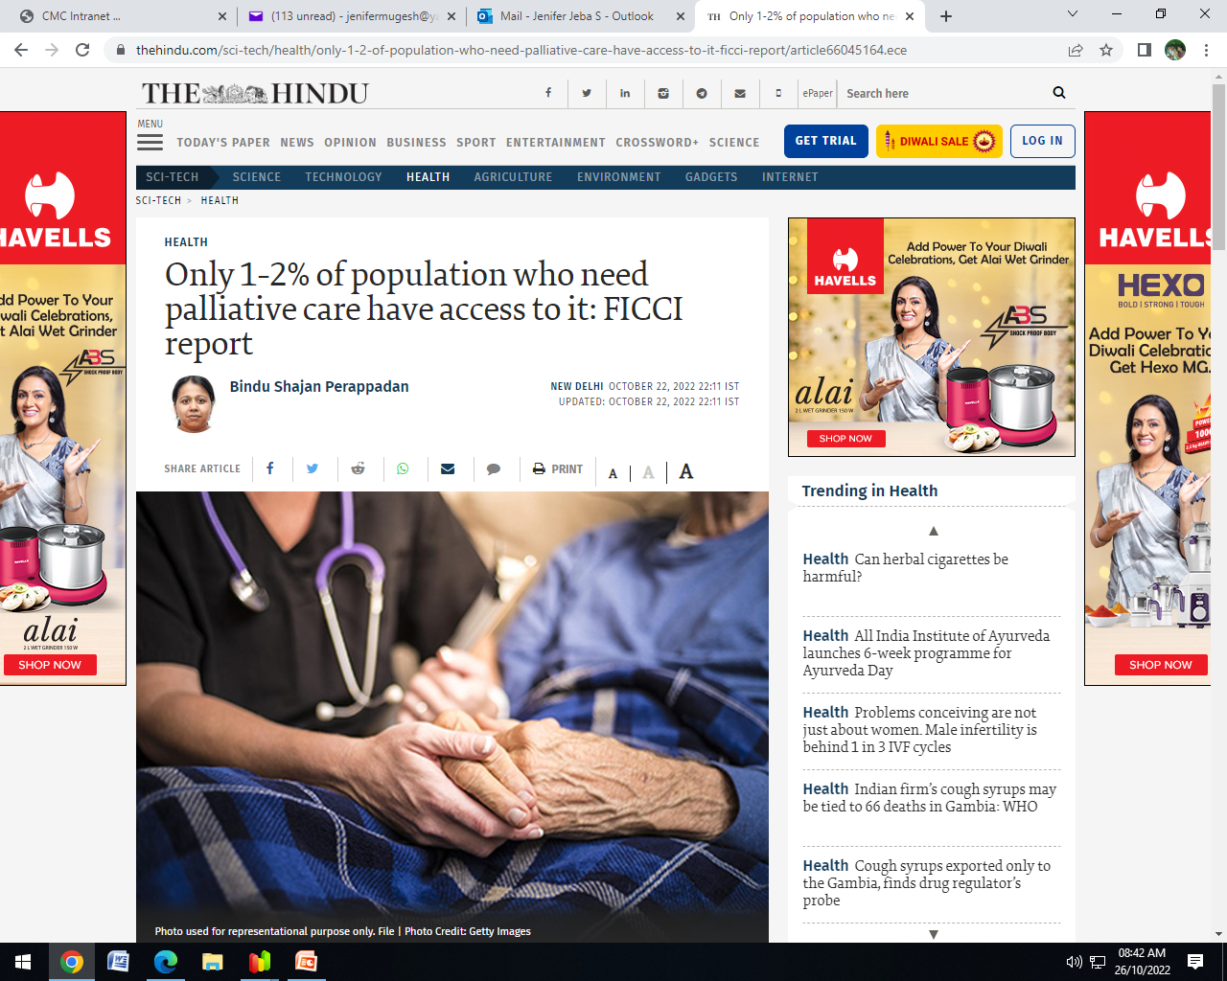
Palliative care in India – existing mismatch
Quality of death and dying
2021 - 59/ 81 (2015 - 67/80)
Limited educational opportunities/ workforce
Cross Country Comparison of Expert Assessments of the Quality of Death and Dying 2021. Journal of Pain and Sym Management (Article in Press)
https://www.thehindu.com/sci-tech/health/only-1-2-of-population-who-need-palliative-care-have-access-to-it-ficci-report/article66045164.ece

Slide 10
The URGENT mandate
The United Nations Committee on Economic, Social and Cultural rights report that it is essential to provide
“attention and care to chronically and terminally ill persons, sparing them avoidable pain, and enabling them to die with dignity.”

Slide 11
Global moves
2014 - World Health Assembly (WHA) committed countries to integrating palliative care into their health systems
2017 – WHO updated the definition of universal health coverage —Sustainable Development Goal 3.8—to include palliation along with promotion, prevention, treatment, and rehabilitation
2017 - Lancet Commission highlighted the global need to take action when 61 million people are living with serious health-related suffering due to uncontrolled pain and without access to an affordable essential package for palliative care.

Slide 12
Universal health coverage
UHC means that all people and communities can use the promotive, preventive, curative, rehabilitative and palliative health services they need, of sufficient quality to be effective, while also ensuring that the use of these services does not expose the user to financial hardship.

Slide 13
India- National Health Policy 2017
Comprehensive primary health care package - includes geriatric health care, palliative care and rehabilitative care services
Empower general practitioners in the community through distance and continuing education program.

Slide 14
Response to this HUGE NEED
All health care professionals need to be equipped with appropriate skills to deliver primary palliative care
Primary Palliative Care can be part of the solution to this BIG need

Slide 15

IAPC and AFPI – Task force Towards ‘Universal Approach to Palliative Care’ Dec 2016
Awareness
Engage
Educate
Empower
Integrate

Slide 16
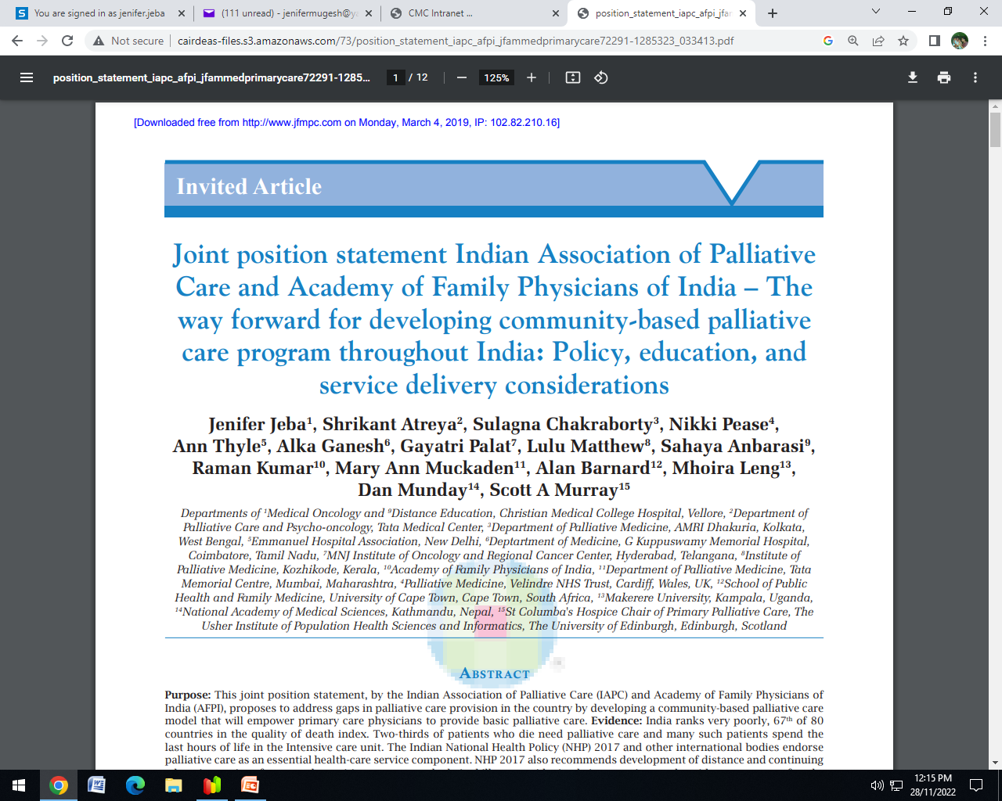
Jeba J, Atreya S, Chakraborty S, Pease N, Thyle A, Ganesh A, et al. Joint position statement Indian association of palliative care and academy of family physicians of India – The way forward for developing community-based palliative care program throughout India: Policy, education, and service delivery considerations. J Family Med Prim Care 2018;7:291-302.
Recommendations:
Palliative care should be integrated into all levels of care including primary care with clear referral pathways, networking between palliative care specialist centers and family medicine physicians and generalists in community settings, to support education and clinical services.
Implement the recommendations of NHP 2017 to develop services and training programs for upskilling of primary care doctors in public and private sector.
Include palliative care as a mandatory component in the undergraduate (MBBS) and postgraduate curriculum of family physicians.
(4) Improve access to necessary medications in urban and rural areas.
(5) Provide relevant in‑service training and support for palliative care to all levels of service providers including primary care and community staff.
(6) Generate public awareness about palliative care and empower the community to identify those with chronic disease and provide support for those choosing to die at home.

Slide 17
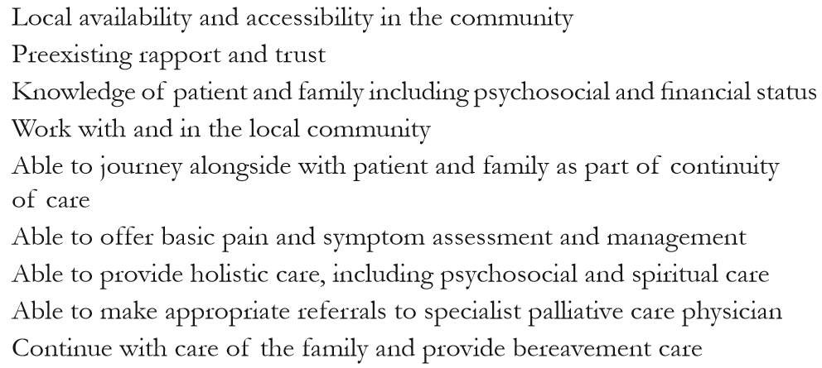
From beginning to end…..
Jeba J, et al. Joint position statement Indian association of palliative care and academy of family physicians of India – The way forward for developing community-based palliative care program throughout India: Policy, education, and service delivery considerations. J Family Med Prim Care 2018;7:291-302.

Slide 18
Primary palliative care
Specialist palliative care
Basic management of
Pain
Symptoms
Depression/ anxiety
Discussions
Prognosis
Goals of treatment
Management of
Refractory pain
Refractory symptoms
Management of
Complex anxiety, depression, grief, existential distress
Conflict resolution
On goals
Within family/ health prof
Addressing futility issues
Quill TE, Abernethy AP. N Engl J Med 2013;368:1173-1175.

Slide 19
Palliative Care – why early identification and integration?

Slide 20
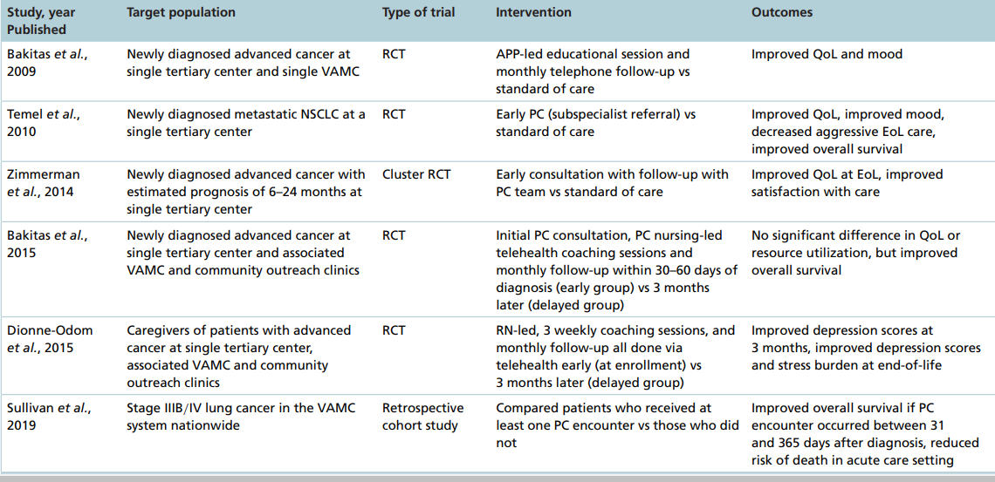
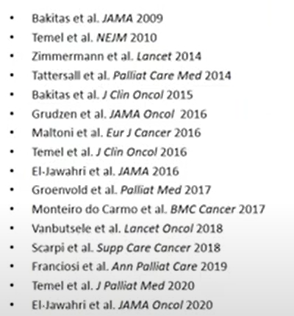
Early palliative care integration – Evidence based benefits - cancer

Slide 21
Early Palliative Care—better outcomes
Patient and family
Health care system
Better symptom control
Fewer depressive symptoms
Better QOL
Less aggressive care at EoL
Better survival
Helps navigate the difficult disease process
Facilitates treatment decision-making and advance care planning
Enhances patient and care giver satisfaction
Promotes effective health care utilization
Reduces health costs -reducing length of stay in hospital and hospital admissions
Temel JS, et al. . Effects of Early Integrated Palliative Care in Patients With Lung and GI Cancer: A Randomized Clinical Trial. J Clin Oncol. 2017;35:834-41.
Zimmermann C, et al. Effectiveness of specialized palliative care- systematic review. JAMA 2008;299:1698-1709.

Slide 22
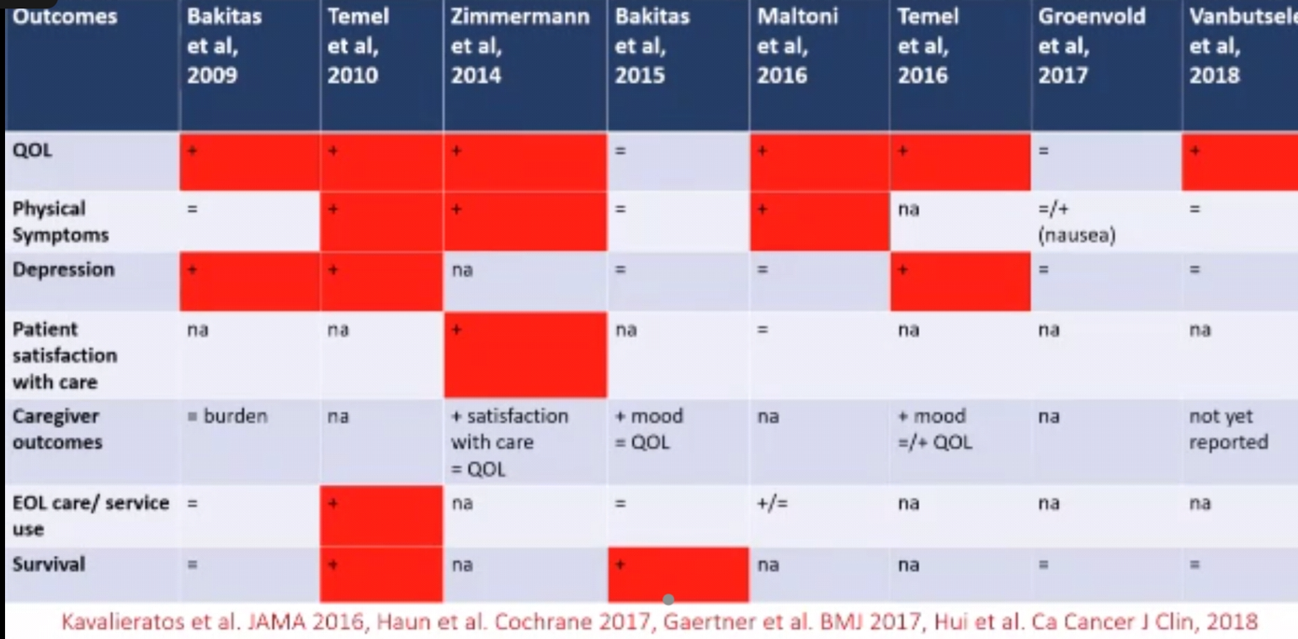
Early Palliative Care - trials

Slide 23
Palliative care – when/ how to identify?

Slide 24
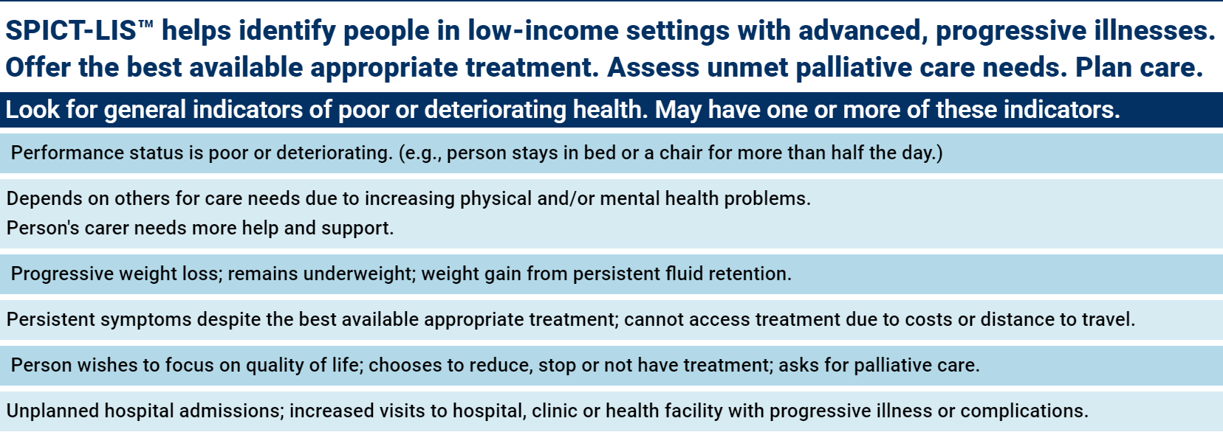
Supportive and Palliative Care Indicator Tool - LIS
https://www.spict.org.uk/e-spict-lis/

Slide 25
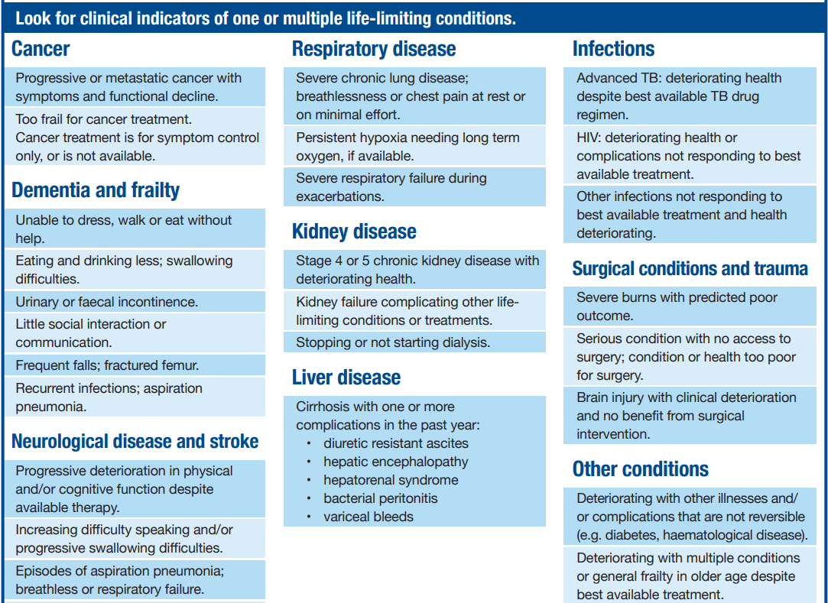
https://www.spict.org.uk/e-spict-lis/

Slide 26

Identify early to integrate palliative care - WHY?
Care from the BEGINNING to the END at point of need
Address suffering early/ continuum of care
Ensure care ends well
Holistic Assessment – identify changing needs – timely/ regular
Support / plan care / co-ordinate
Can network with specialist palliative care physicians when needed
https://www.spict.org.uk/e-spict-lis/

Slide 27
Who needs palliative care? Should be need based
Cancer
HIV/ AIDs
Dementia
Progressive neurological disorders
Parkinson’s disease
Multiple sclerosis
Motor neuron disease
Stroke
Progressive systemic diseases
COPD, ILD
Heart disease
Liver, kidney dysfunction
Old age/ degenerative disorders

Slide 28
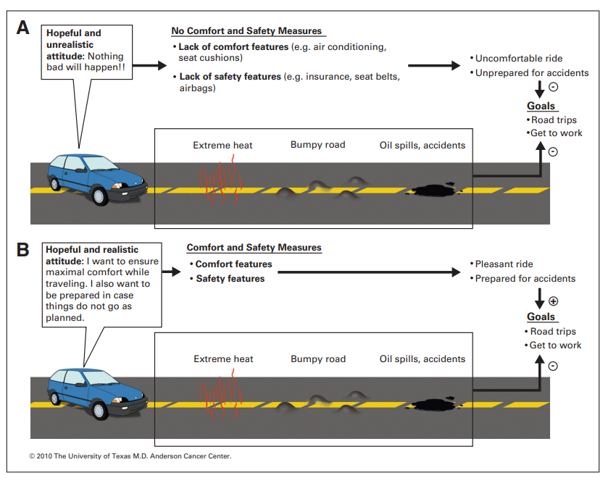
Cheng WW, et al: Interval between palliative care referral and death among patients treated at a comprehensive cancer center. J Palliat Med 8:1025-1032, 2005
Bruera E, Hui D. Integrating supportive and palliative care in the trajectory of cancer: establishing goals and models of care. J Clin Oncol. 2010 Sep 1;28(25):4013-7
Notes:
To initiate discussions on goals of care - The use of a car is an analogy for setting goals of care. (A) A hopeful and unrealistic driver wishes that nothing bad will happen on the road. This is in contrast to (B) the hopeful and realistic driver, who knows the importance of comfort measures and of being prepared for the trip ahead

Slide 29
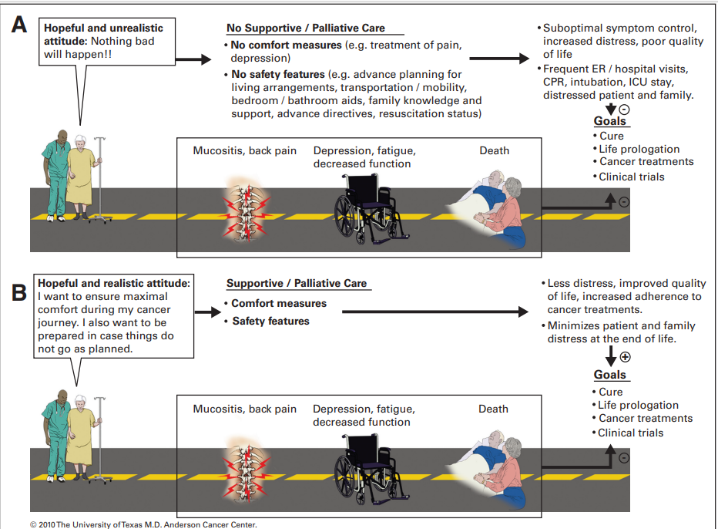
Referral to palliative care
Occurs late
30 - 60 days before death
late palliative care is a missed opportunity to do better for patients, families, and health services.
About comfort and being prepared
Bruera E, Hui D. Integrating supportive and palliative care in the trajectory of cancer: establishing goals and models of care. J Clin Oncol. 2010 Sep 1;28(25):4013-7
Notes:
A hopeful and unrealistic patient focuses on cancer cure and life-prolongation measures, without paying attention to her symptoms and advance care needs. This results in unnecessary distress for patients and families. This is in contrasts to (B) a hopeful and realistic patient, who has the same goals for cancer control, but is better equipped to manage symptoms and prepared for crisis because of the concurrent use of supportive/palliative care. ER, emergency room, CPR, cardiopulmonary resuscitation, ICU, intensive care unit

Slide 30
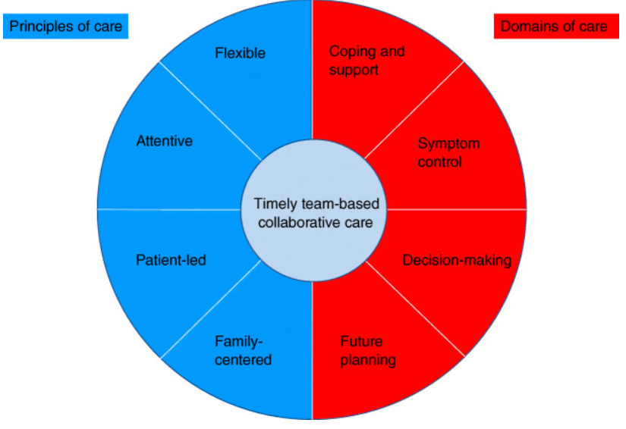
Early palliative care
Mathews J, et al. Models of Integration of Specialized Palliative Care with Oncology. Curr Treat Options Oncol. 2021;22(5):44.

Slide 31
Early identification – by whom?
All health care workers
Primary care workers – Family physicians, nurse, other grass root level
Any setting (home/ community/ primary health care setting/ hospitals/ institutions)
Care givers
Patients

Slide 32
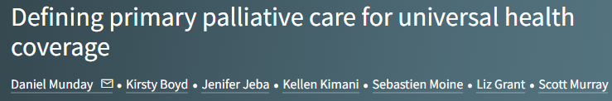
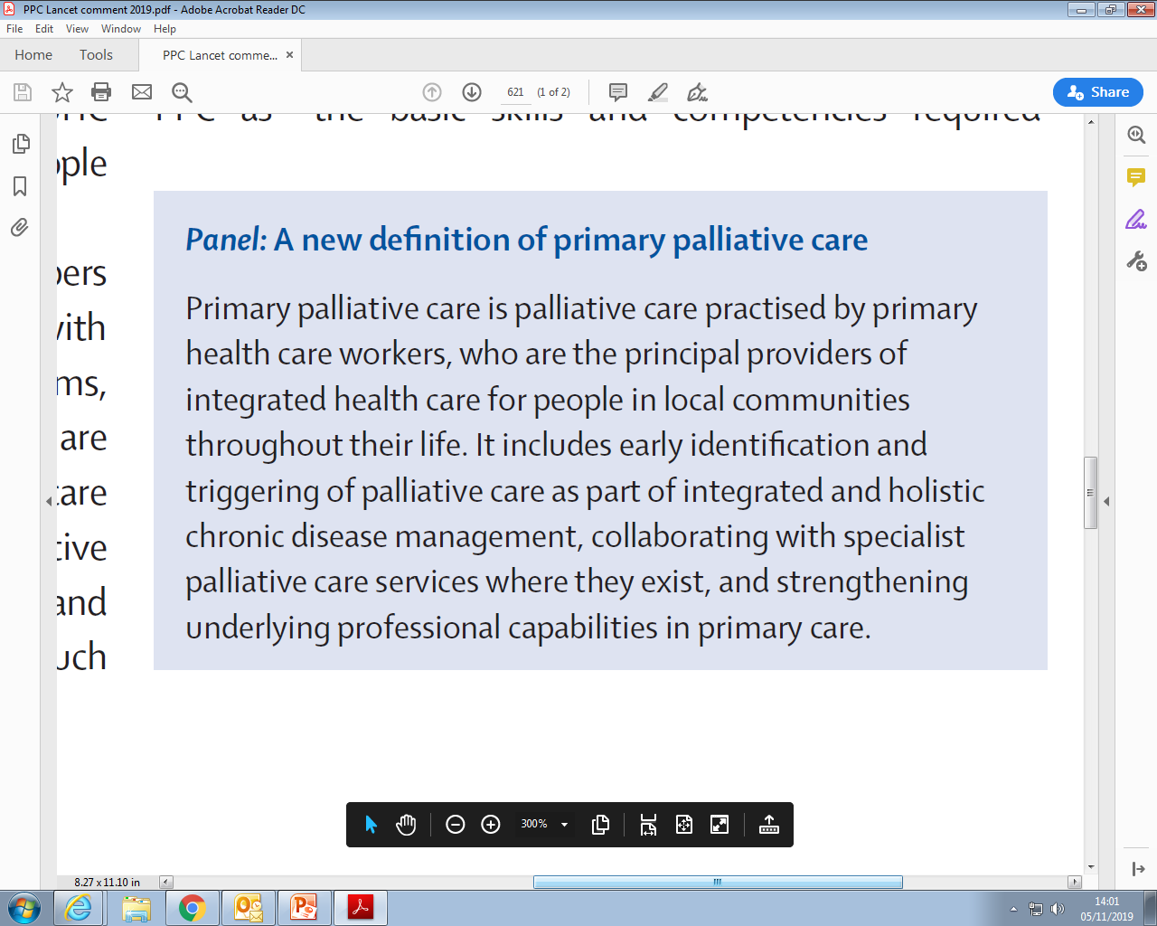
Munday D, Boyd K, Jeba J, Kimani K, Moine S, Grant L, Murray S. Defining primary palliative care for universal health coverage. Lancet. 2019 Aug 24;394(10199):621-622. doi: 10.1016/S0140-6736(19)31830-6.

Slide 33
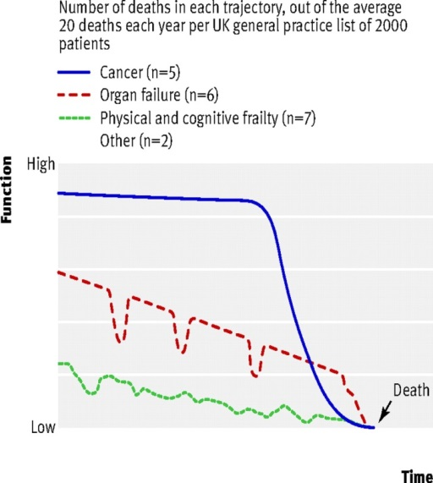
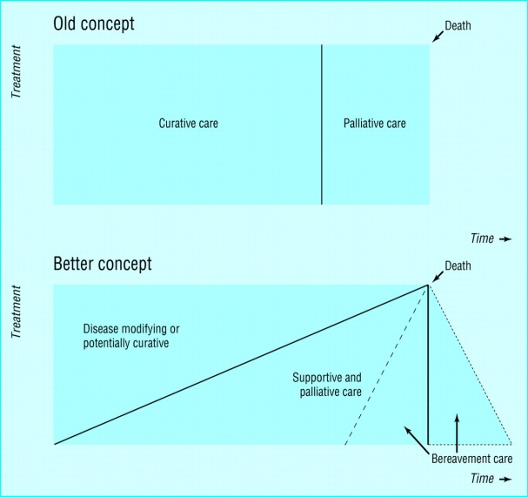

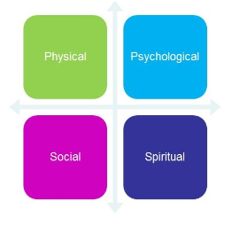

Primary Care can deliver Palliative Care 5 ALLs
CURATIVE
PALLIATIVE
Cancer
DISEASE MODIFYING
Organ failure
Frailty
SUPPORTIVE AND PALLIATIVE CARE
1. All illnesses 2. All times
CARE HOME
HOSPITAL
AT HOME
HOSPICE
4. All settings
3. All dimensions
5. All nations
Notes:
Others: carers. Promoting a discourse, and community development

Slide 34
1. All illness – 3 illness trajectories
Acute – typically cancer
Intermittent – typically organ failure
Gradual decline – typically frailty, dementia, stroke

Slide 35
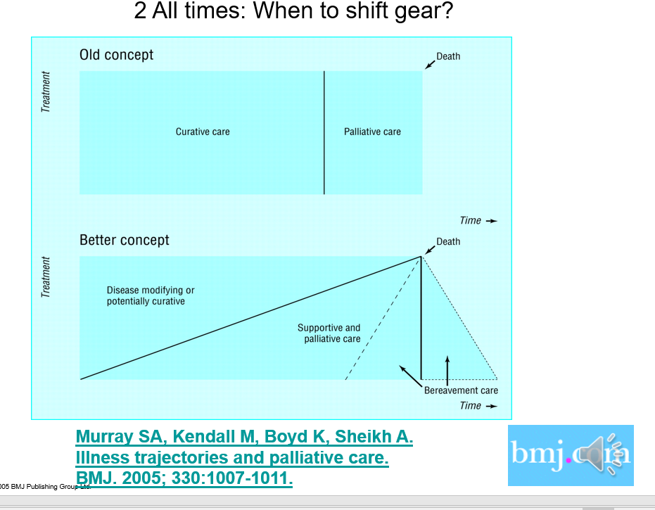
2. All times
From diagnosis to death
Early identification – need based

Slide 36

All times
Function
Caring for people with organ failure: 3 stages
High
Stage 1 Physically well
Stage 2 Active supportive and palliative care
Care
Plan
Stage 3 Terminal or late palliative care
Last weeks or days Care
Sentinel
events
Boyd K and Murray SA . Recognising and managing key transitions in end of life care.
BMJ 2010;341:c4863.
Early palliative
Care in primary care
Death
Low
Time
Notes:
How do this with non-malignant disease?
Our team has written these three stages into the new European HF guidance on palliative care, and in British guidance to GPs to help palliative in COPD
Avoid futile treatment

Slide 37
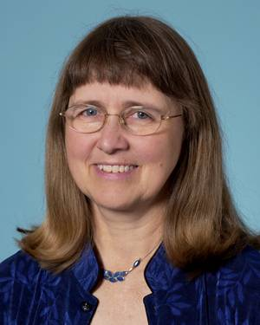
Prognostication
“Would I be surprised
if Mrs A were to die within
the next 12 months?”
Avoid “prognostic paralysis*
Can start and then stop of person improves
According to need not prognosis or diagnosis
Joanne Lynn USA
*Murray SA, Boyd K, and Sheikh A. Palliative care in chronic illnesses: we need to move from prognostic paralysis to active total care. BMJ 2005. 330:611-12.

Slide 38
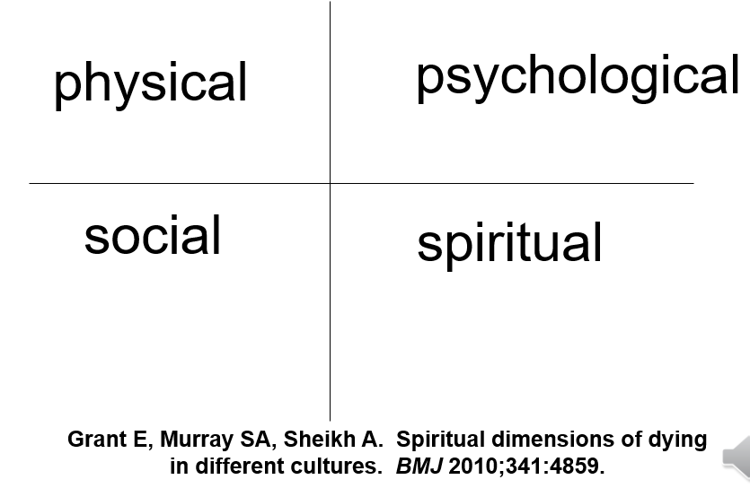
3. All dimensions of need
Living and Dying is 4 dimensional
Scott A Murray et al. BMJ 2017;356:bmj.j878
Wellbeing trajectories in patients with conditions such as cancer causing rapid functional decline.

Slide 39
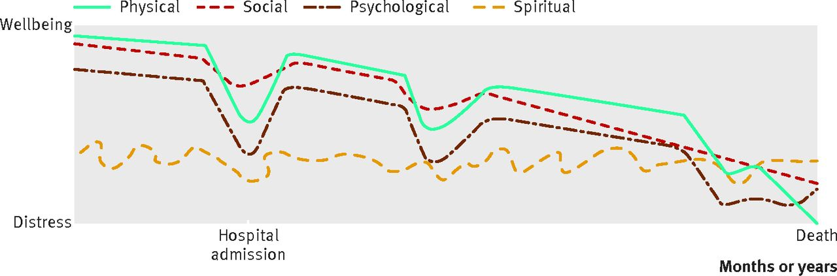


Wellbeing trajectories in patients with intermittent decline (typically organ failure or multimorbidity).
Scott A Murray et al. BMJ 2017;356:bmj.j878
©2017 by British Medical Journal Publishing Group
Notes:
Fig 2 Wellbeing trajectories in patients with intermittent decline (typically organ failure or multimorbidity)‏

Slide 40
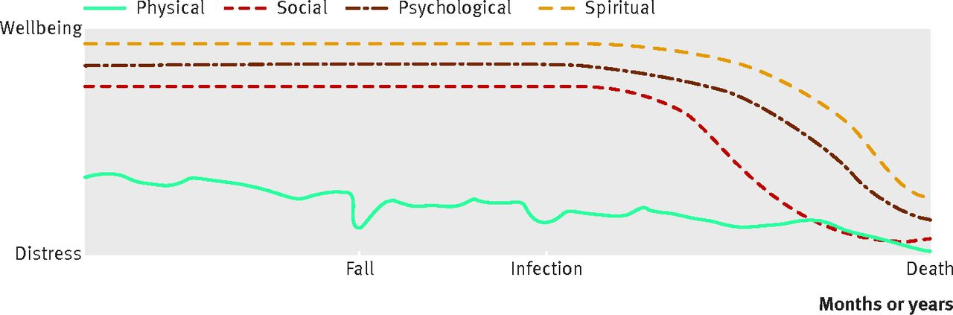
Wellbeing trajectories in patients with gradual decline (typically frailty or cognitive decline).
Scott A Murray et al. BMJ 2017;356:bmj.j878
©2017 by British Medical Journal Publishing Group
Notes:
Fig 3 Wellbeing trajectories in patients with gradual decline (typically frailty or cognitive decline)‏

Slide 41

Care-givers trajectory Fluctuations of physical, psychological, social and spiritual wellbeing in family carers of patients with lung cancer.

Slide 42
4. All settings
Primary care - in clinics, community, in care homes – nursing and residential
In hospital - wards and clinics
In hospices –but remember all illnesses
Unscheduled / out-of-hours / emergency care

Slide 43
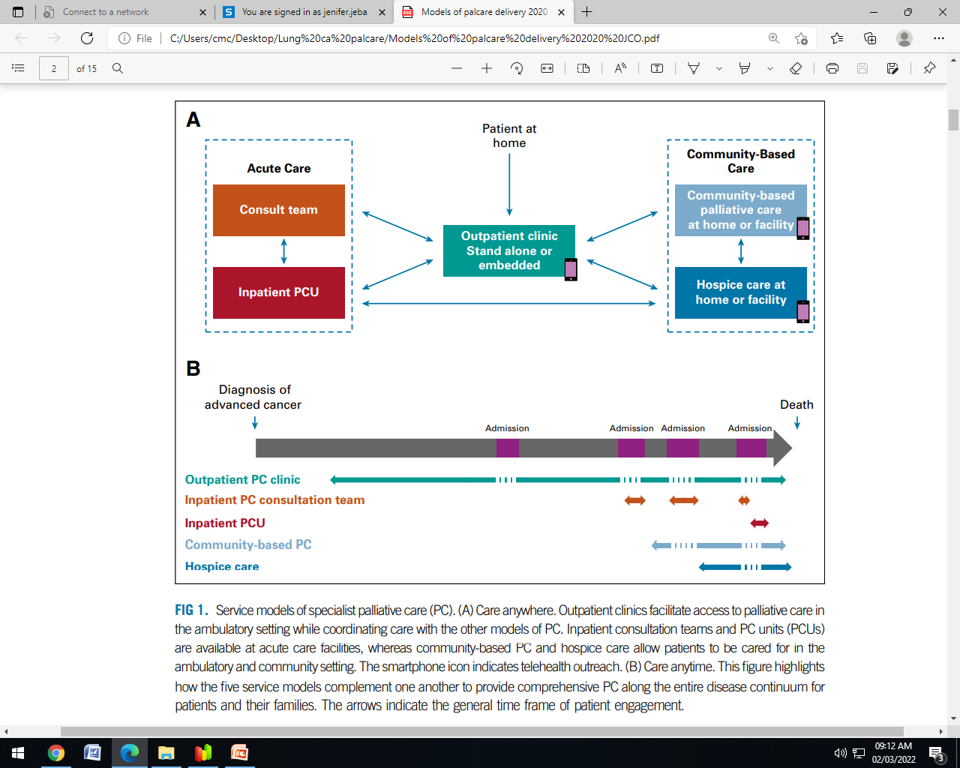
Palliative care service models
Tele-health
Hui D, Bruera E. Models of Palliative Care Delivery for Patients With Cancer. J Clin Oncol. 2020;38(9):852-865
Mathews J, et al. Models of Integration of Specialized Palliative Care with Oncology. Curr Treat Options Oncol. 2021;22(5):44. Published 2021 Apr 8.

Slide 44
5. All nations and countries
High income
Low and middle income

Slide 45
Barriers to integration
Health care professional
Patient/ care-giver
Stigma –” palliative care” term – equate to end of life care
Incompatible with disease treatment
Will destroy patient’s hope
Form of abandonment
Fear of eroding the doctor -patient relationship
Lack of confidence - initiating referral discussions
Stigma –” palliative care” – equate to end of life care
Less awareness
Palliative care team seen as “pain team”
Dalal S, Palla S, Hui D, et al: Association between a name change from palliative to supportive care and the timing of patient referrals at a comprehensive cancer center. Oncologist 16:105-111, 2011
Fadul N, Elsayem A, Palmer JL, et al: Supportive versus palliative care: What’s in a name?—A survey of medical oncologists and midlevel providers at a comprehensive cancer center. Cancer 115:2013-2021, 2009

Slide 46
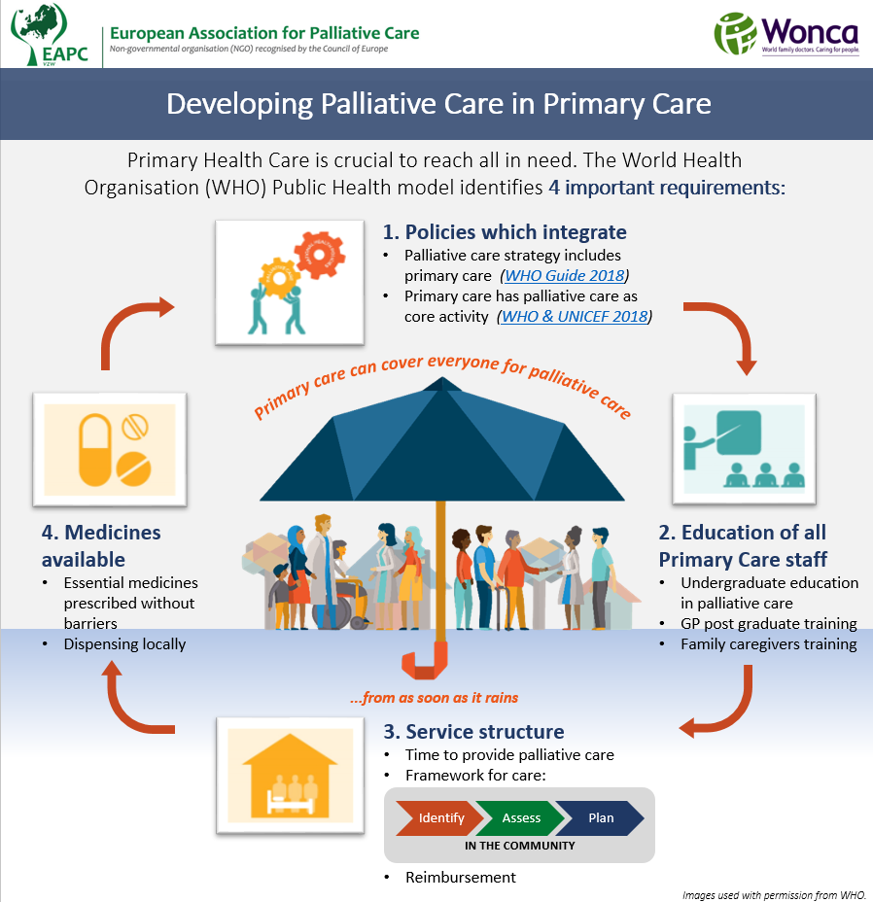

Slide 47
To conclude
Palliative care is NOT end-of-life care
Early integration of palliative care improves patient and health care outcomes
Identify early, assess and support needs in all four dimensions
Consider targeted model / need based palliative care integration
Ongoing training and education in palliative care
“To cure sometimes, to relieve often, to comfort always”
-Dr. Edward Trudeau (1800s)

Slide 48

Palliative care FOR ALL (universal)
From Beginning to End
Early Start - Good Finish
ALL WHO need
WHEN they need
WHERE they need
UNTIL they need
Provided by all health care professionals
With collaboration with specialist palliative care physicians when needed
https://thumbs.dreamstime.com/b/vision-letter-cubes-focus-other-cubes-wooden-table-92115875.jpg

Slide 49


September2018

Slide 50
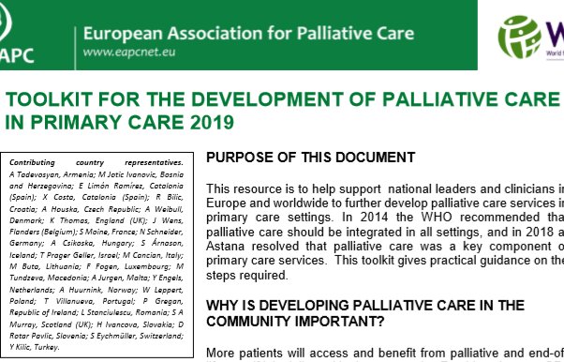

Slide 51
Resources
http://www.ed.ac.uk/usher/primary-palliative-care
Early Palliative Care: a video for health and care professionals
Using the Supportive and Palliative Care Indicators Tool – Low Income Settings (SPICT-LIS)
https://www.spict.org.uk/e-spict-lis/
Murray SA et al BMJ 2017; 356 doi: https://doi.org/10.1136/bmj.j878
Or watch Palliative care from diagnosis to death – YouTube ,
EAPC Primary Care Reference Group Open Meeting goes live at #EAPC2020

